Slide 1


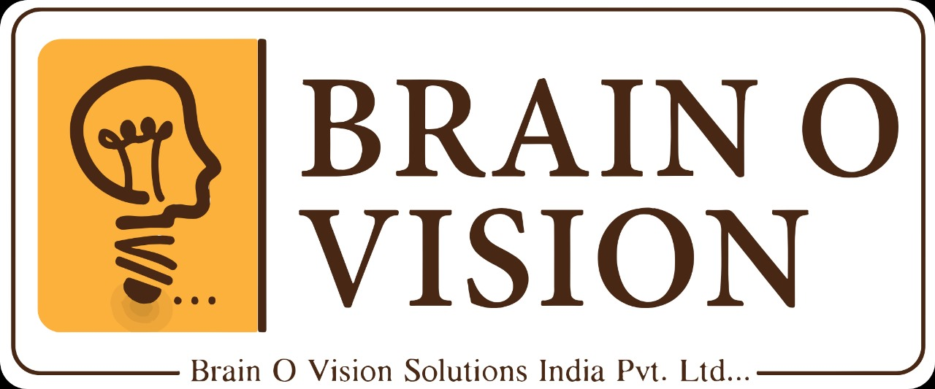
DIGITAL SOLUTION FOR GOOD GOVERNANCE AND JUSTICE

Slide 2
PROBLEM STATEMENT
"Governments and justice systems face challenges like corruption, inefficiency, and limited accessibility.
Many institutions still rely on outdated systems, leading to delays and a lack of transparency.
A digital transformation is essential to improve service delivery, ensure accountability, and make justice and governance accessible to all citizens."

Slide 3
SOLUTION
A Digital Application to enhance transparency, efficiency, and accessibility in governance and justice systems. The platform provides digital solutions for citizens to access legal aid, track government services, report corruption, and participate in decision-making processes.

Slide 4
Out comes

Slide 5
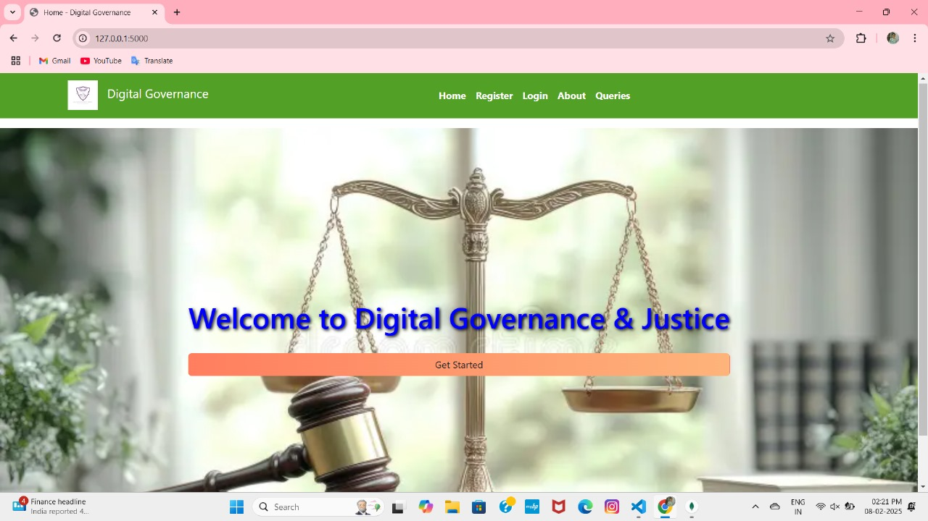

Slide 6
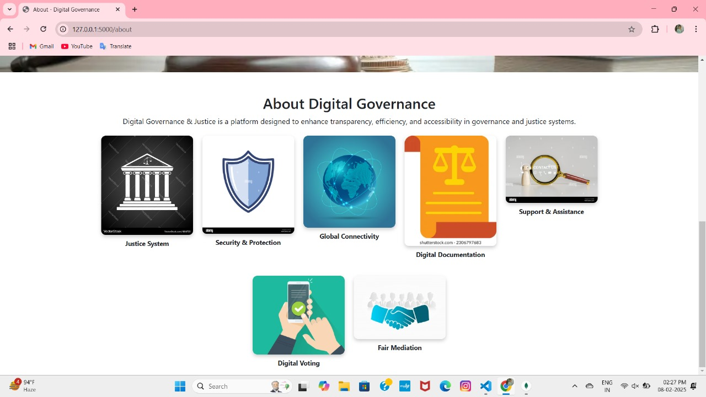

Slide 7
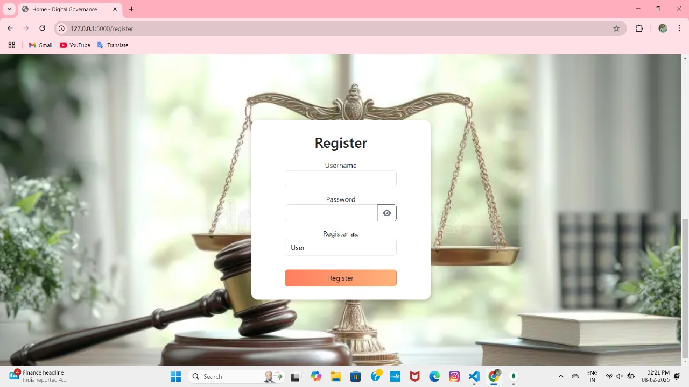

Slide 8
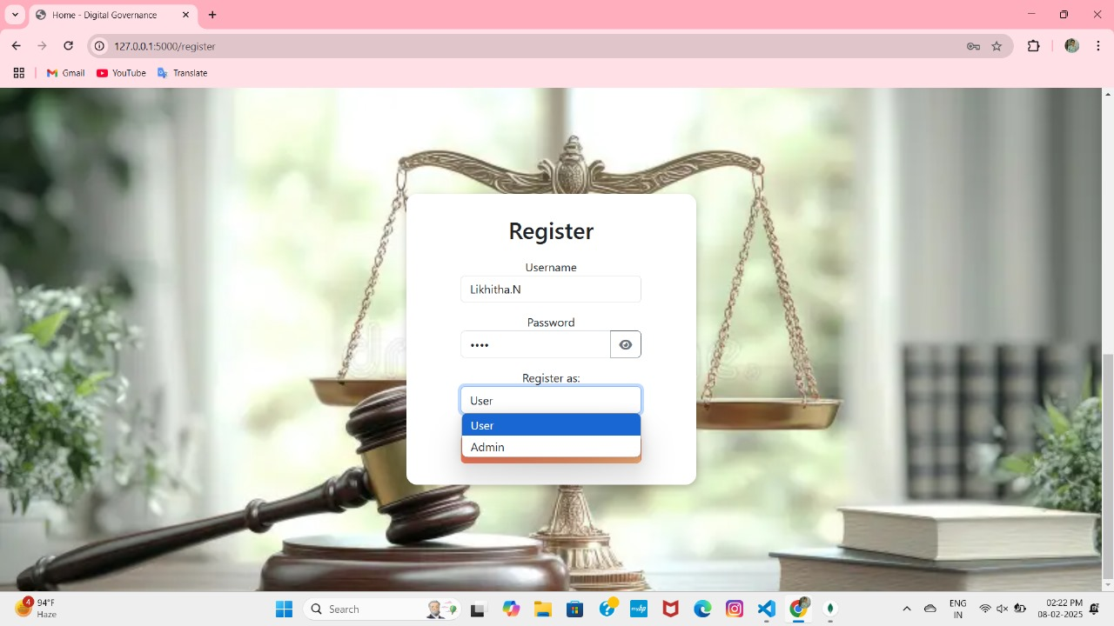

Slide 9
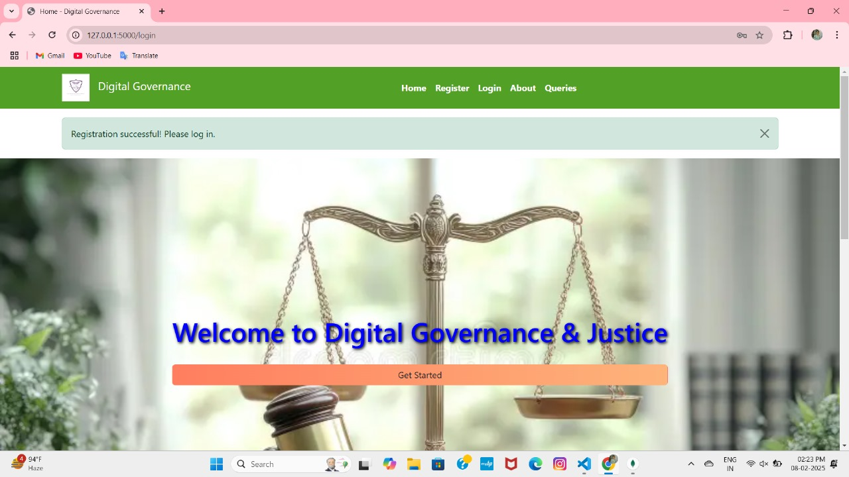

Slide 10
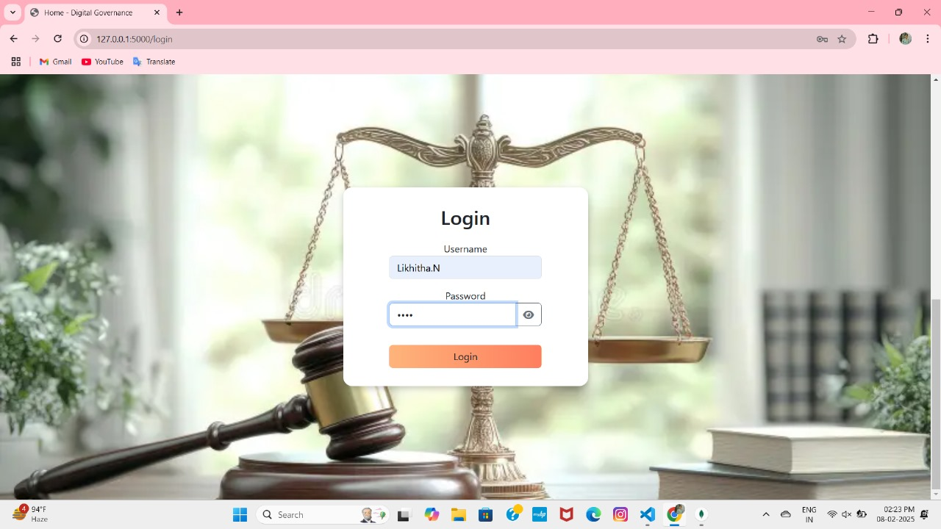

Slide 11
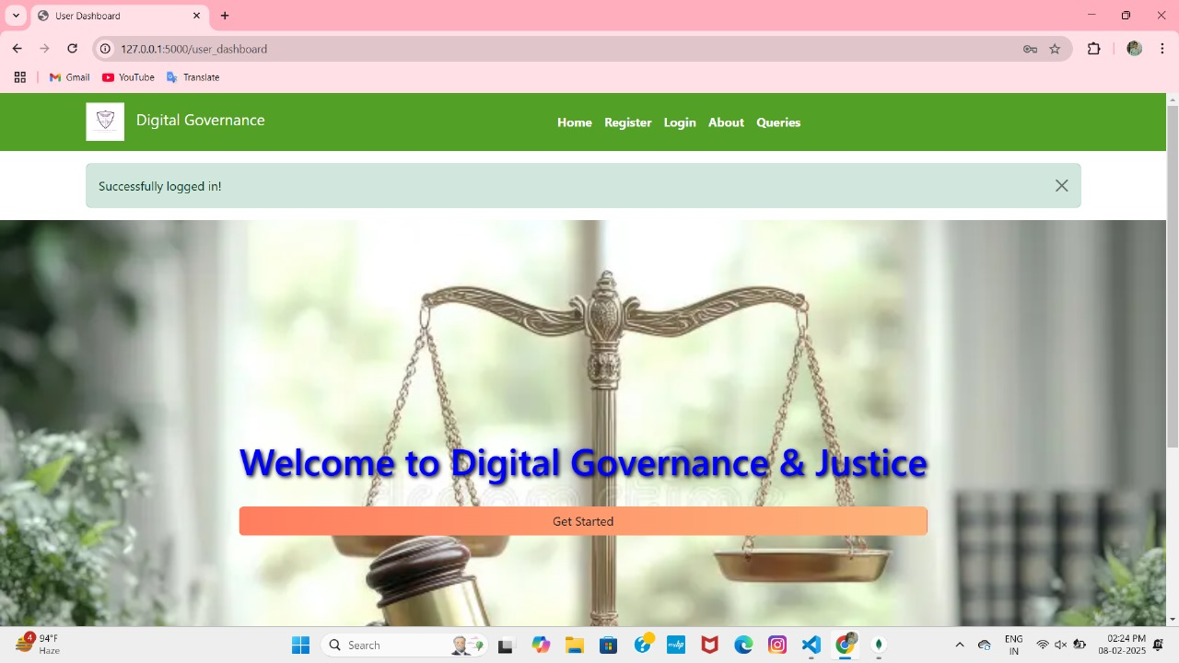

Slide 12
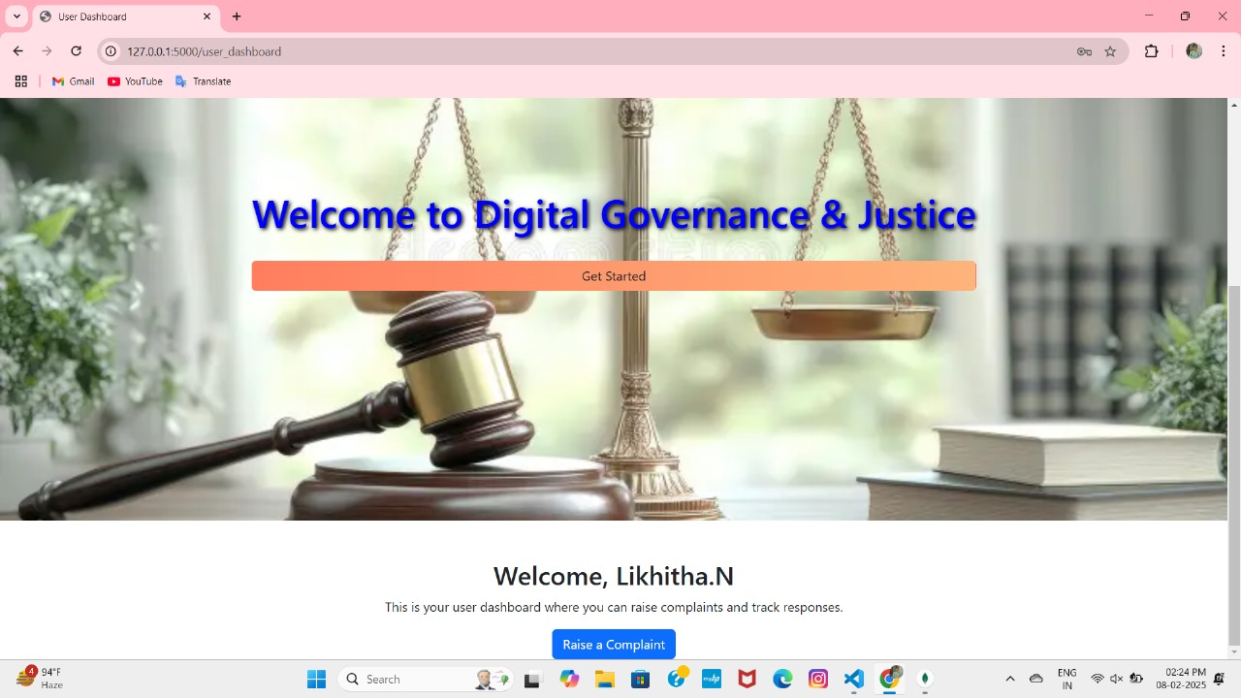

Slide 13
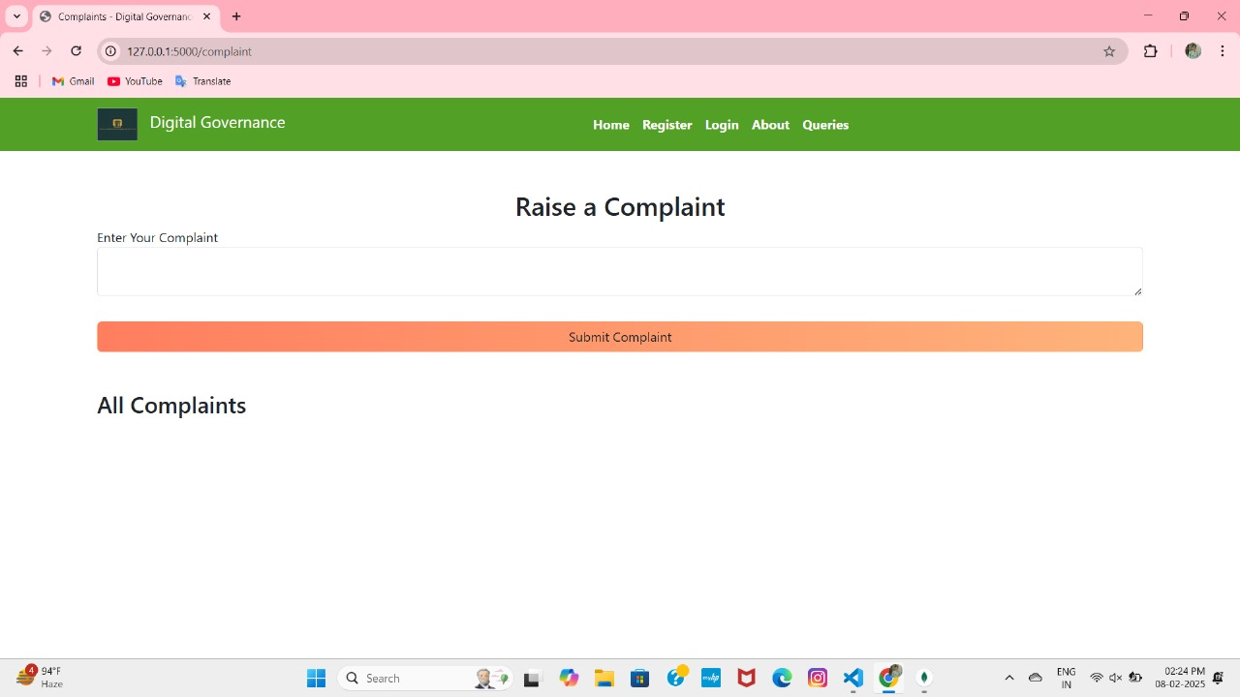

Slide 14
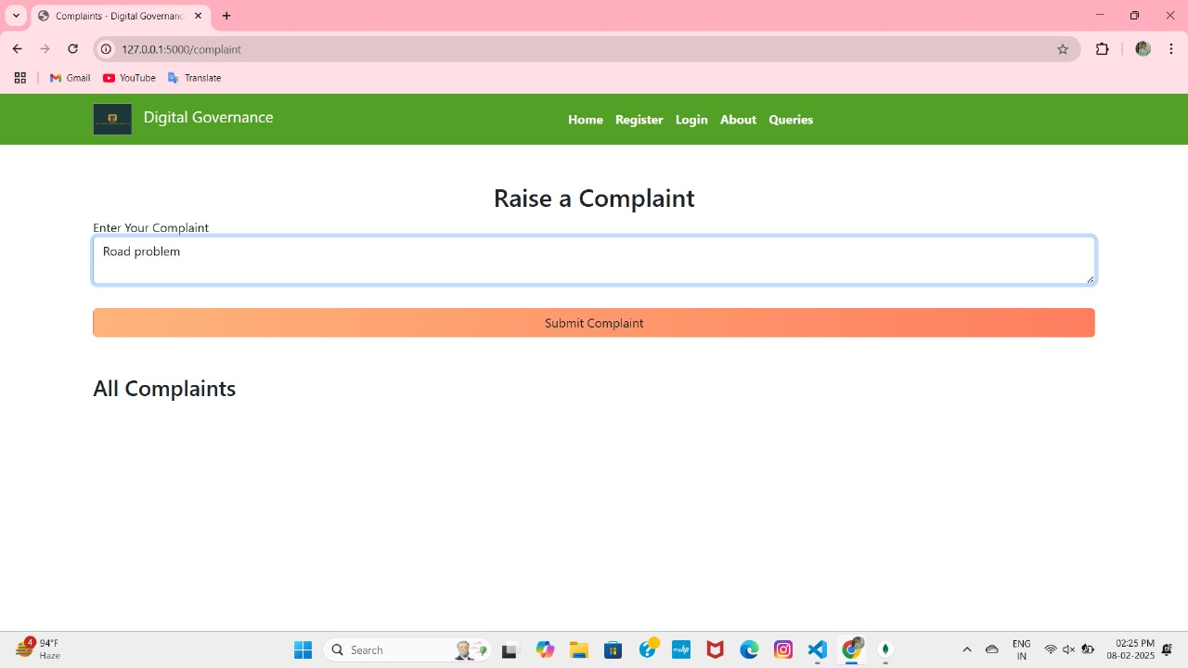

Slide 15


Slide 16
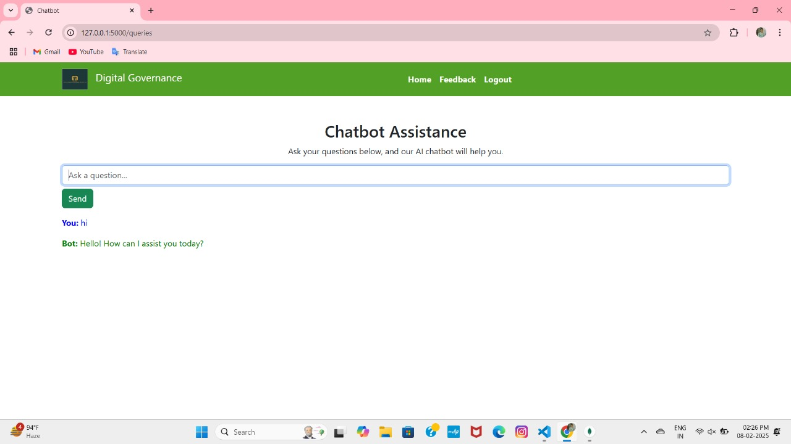

Slide 17
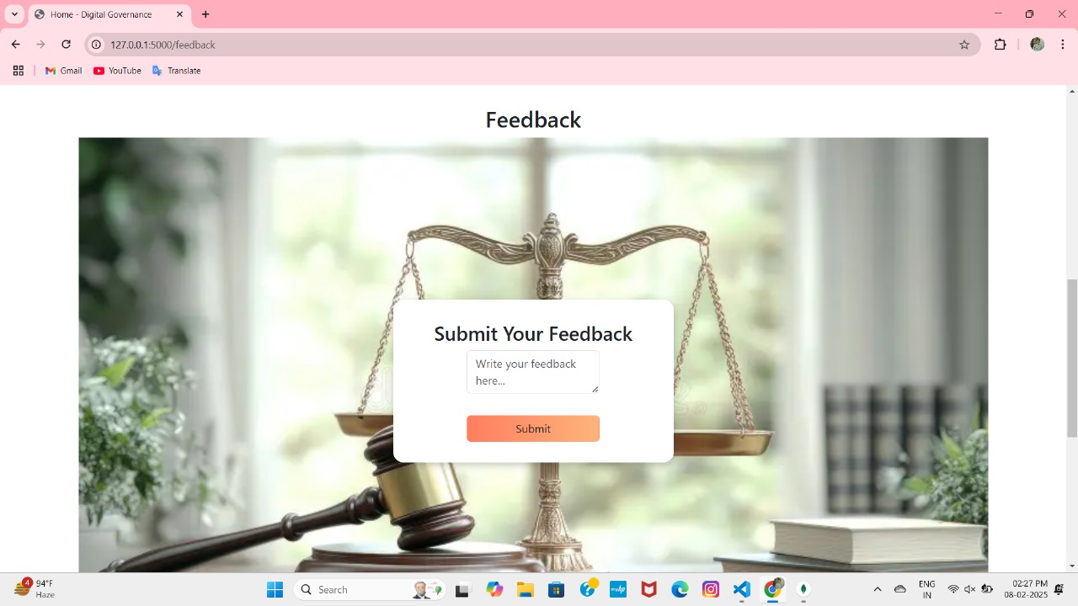

Slide 18


Slide 19
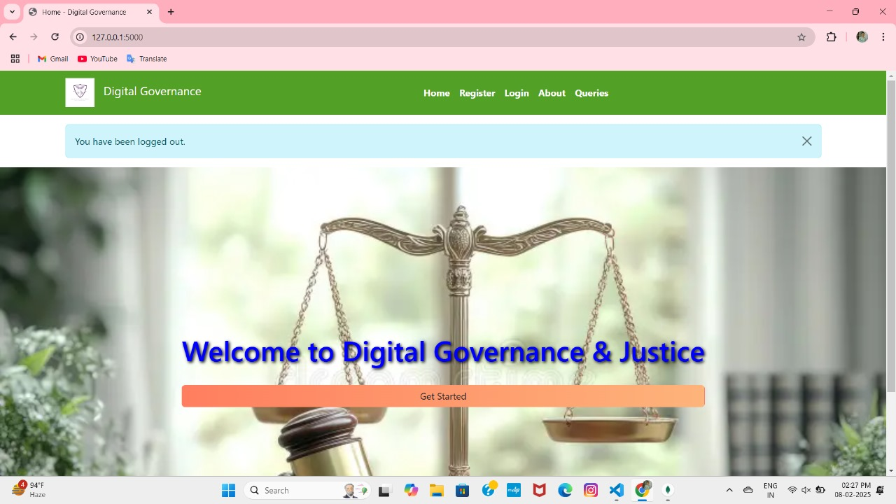

Slide 20
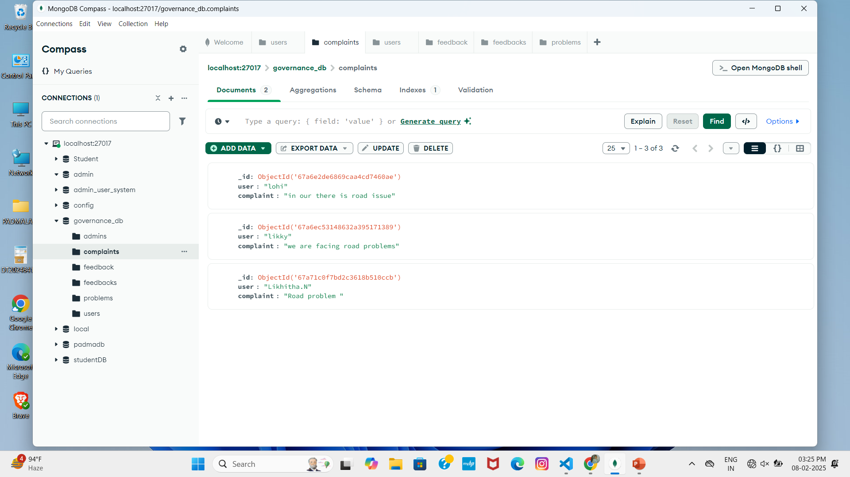

Slide 21
Future enhancement
Blockchain for Transparency
Predictive Analytics for Decision-Making
Multi-Language Support
Mobile Application Integration
Decentralized Governance Portals
AI-Powered Legal Assistance

Slide 22
conclusion
Digital transformation in governance and justice systems is essential to overcoming challenges like corruption,
inefficiency, and limited accessibility. By leveraging modern technologies such as AI, blockchain, and data analytics.
we can enhance transparency, improve service delivery, and ensure equal access to justice for all citizens.
A technology-driven approach will build trust, increase citizen participation, and create a more accountable and
efficient system for the future.

Slide 23
THANKING YOU
GOUTHAMI INSTITUTE OF TECHNOLOGY AND MANAGEMENT FOR WOMEN
BRAIN O VISION

Slide 24
Innominds
N.LIKHITHA(CSE)
N.GURU LOHITHA(CSE(AI&ML))
K.VENKATA PADMALATHA(CSE(AI&ML))
M.SREE HARSHITHA(CSE(AI&ML))
P.SARASWATHI(CSE(AI&ML))
T.V.V.PADMAJA(CSE(AI&ML))

